Slide 1
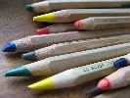
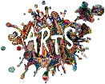
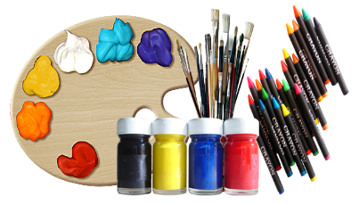
ART 6th – 8th Grade
Mrs. Strait • Room 205 mary.strait@dmschools.org
515-242-8445 Ext.5398
This course is filled with projects and activities that will boost your critical thinking habits, improve your collaborative participation, grow your creativity and develop your communication skills through writing and talking about art. We will focus our exploration of the art world through the Studio Habits.
Grading: Scales will be used for student self-assessment as well as instructor assessment. Grading scale will follow Des Moines Public Schools’ district grading policy. The majority of our work will be assessed using the Studio Habits of Mind:
Develop Craft
Engage & Persist
Envision
Express
Observe
Reflect
Stretch & Explore
Understand Art World
Hetland L., Winner, E., Veenam S., Sheridan, K. (2013) Studio Thinking 2: The Real Benefits of a Visual Arts Education, NY: Teachers College Press
Welcome to
Harding Middle School!
In this class you will:
Generate and conceptualize artistic ideas and work.
Organize and develop artistic ideas and work.
Relate artistic ideas and works with societal, cultural and historical context to deepen understanding.
Interpret intent and meaning in artistic work.
(National Core Art Anchor Standards)
Art at Harding is moving in the direction to become a TAB or teaching for artistic behavior classroom. This will give students more choice in what art media they use to create higher engagement. The goal is to focus students on being able to think creatively, connect ideas from different sources, and practice skills. The semester will start with a review of the art standards and creative process. After this initial review is done we will move into an open studio setting where students will have a certain time period to complete a project with a given theme. All five steps of the creative process and all three standards will be included in each major project and students will be in charge of managing their time and getting everything in on time.
Values at Harding Middle School:
1- We are scholars and CLASS COMES FIRST!
2- Cell phones may not be seen or used unless directed by staff.
3- Direct and indirect profanity will not be tolerated.
4- RESPECT others person and property.
5- We accept the initial response of adults and staff.
2019-2020 Class Syllabus
A little something about Mrs. Strait:
I grew up in Des Moines, Iowa. I received a Bachelor of Arts degree and a Master’s Degree in K-12 Art Education at Drake University.
I am married to my husband Loren who is a minister. I have three children and two step children, three dogs and a cat.
I enjoy creating art, working on my house, working outside doing gardening, and helping students to enjoy creating.
Materials needed daily:
A pencil
Sketchbook (provided)
Growth mindset
Notes:
*Change to Spring Fun for southern Hemisphere
Include pictures of the first term of school. Students working together/students reading books/working on projects or art, etc.

